Slide 1
Transformers for
Language Models
Dr. Víctor Uc Cetina

Slide 2


Slide 3
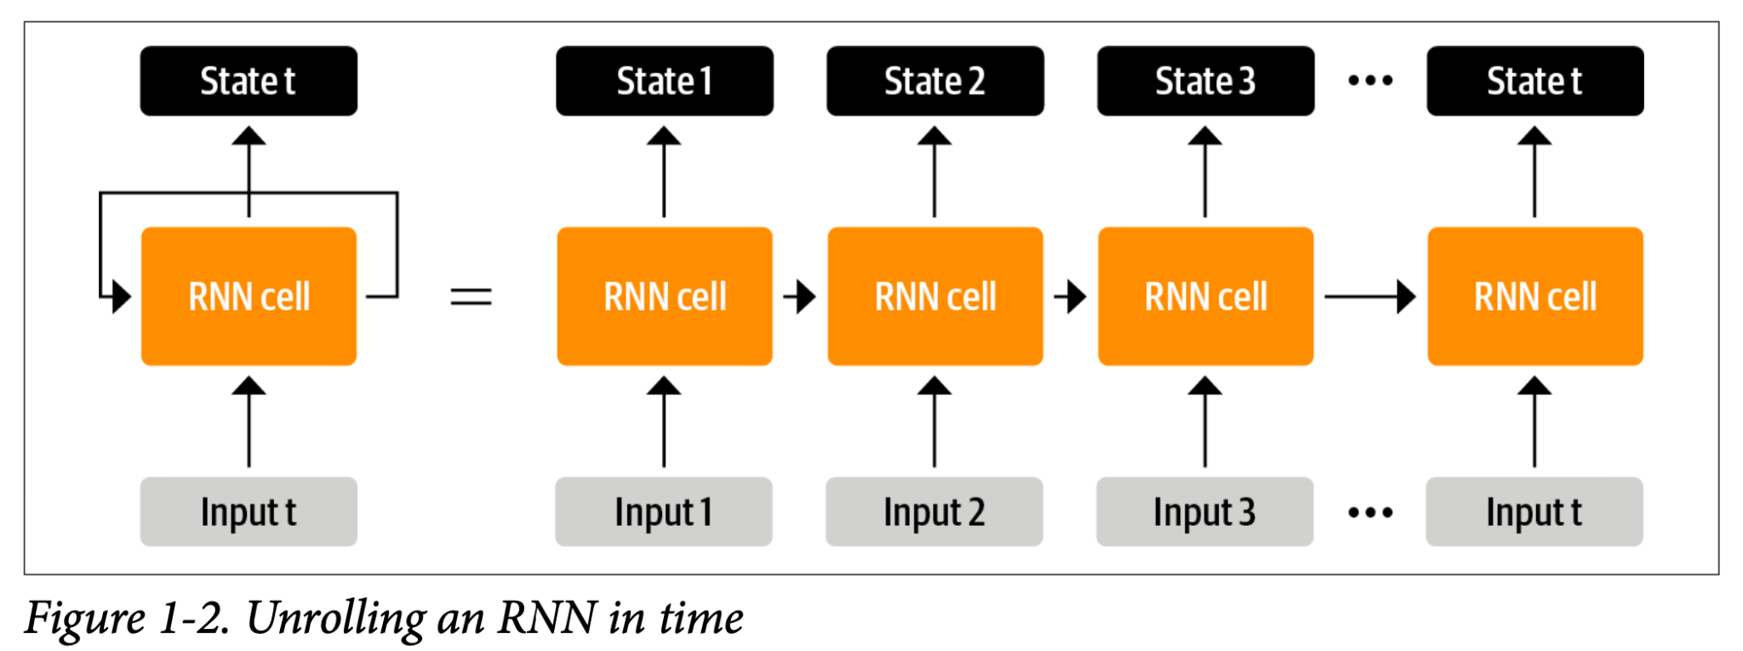

Slide 4
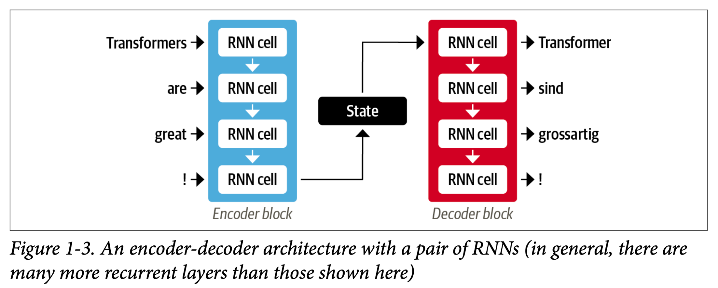

Slide 5
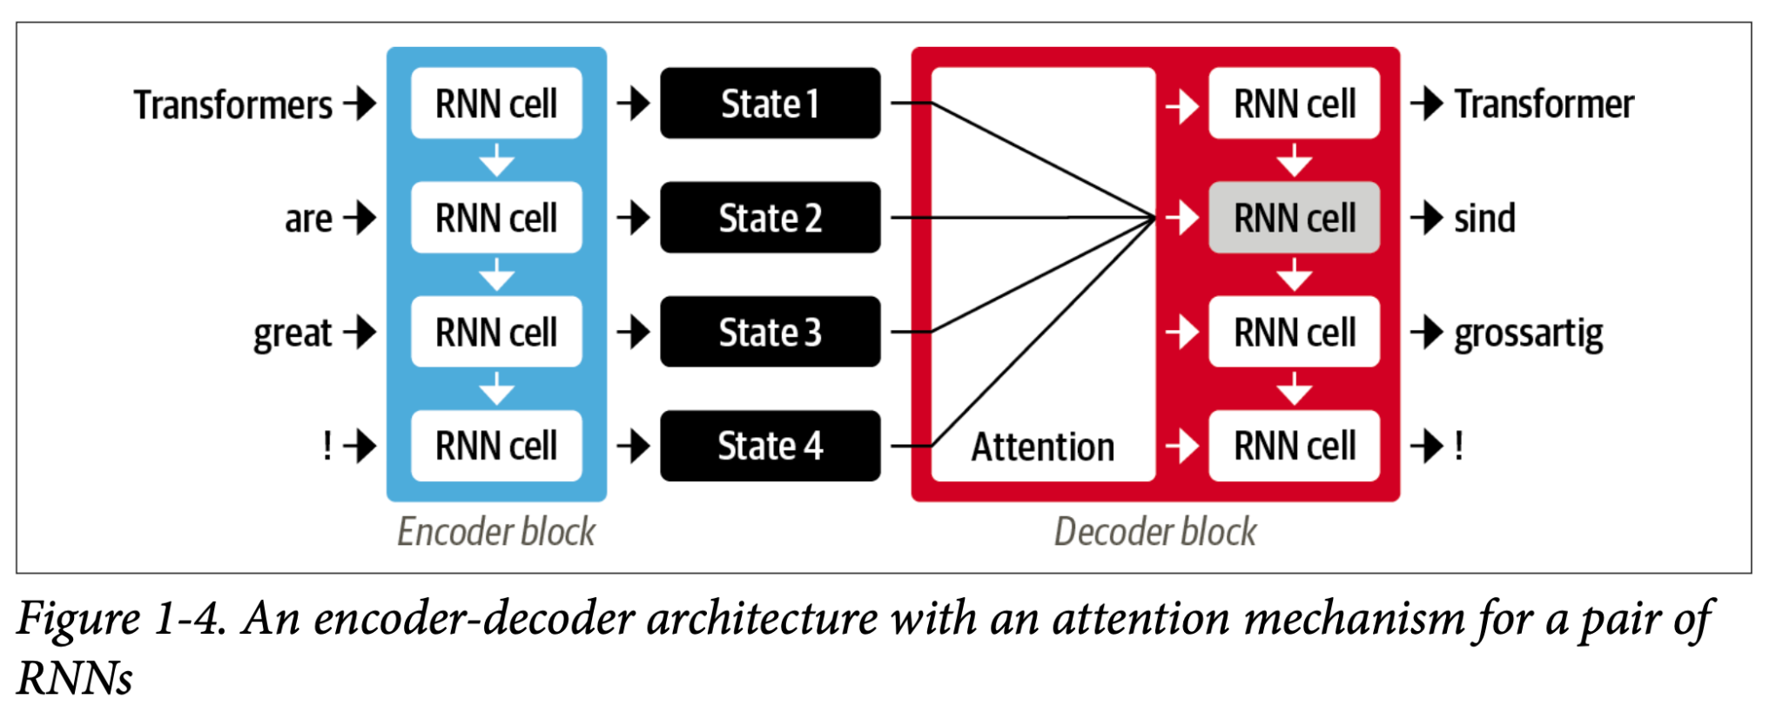

Slide 6
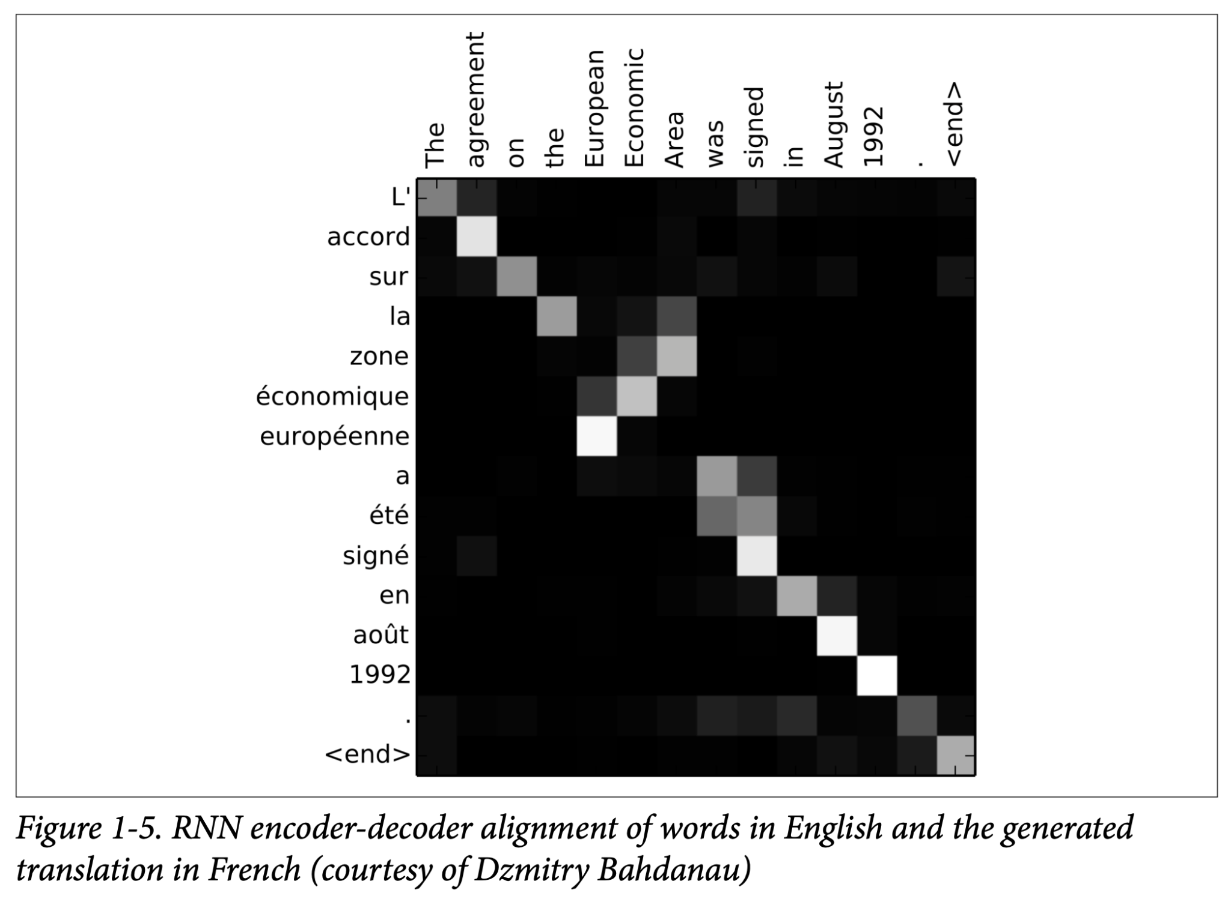

Slide 7


Slide 8
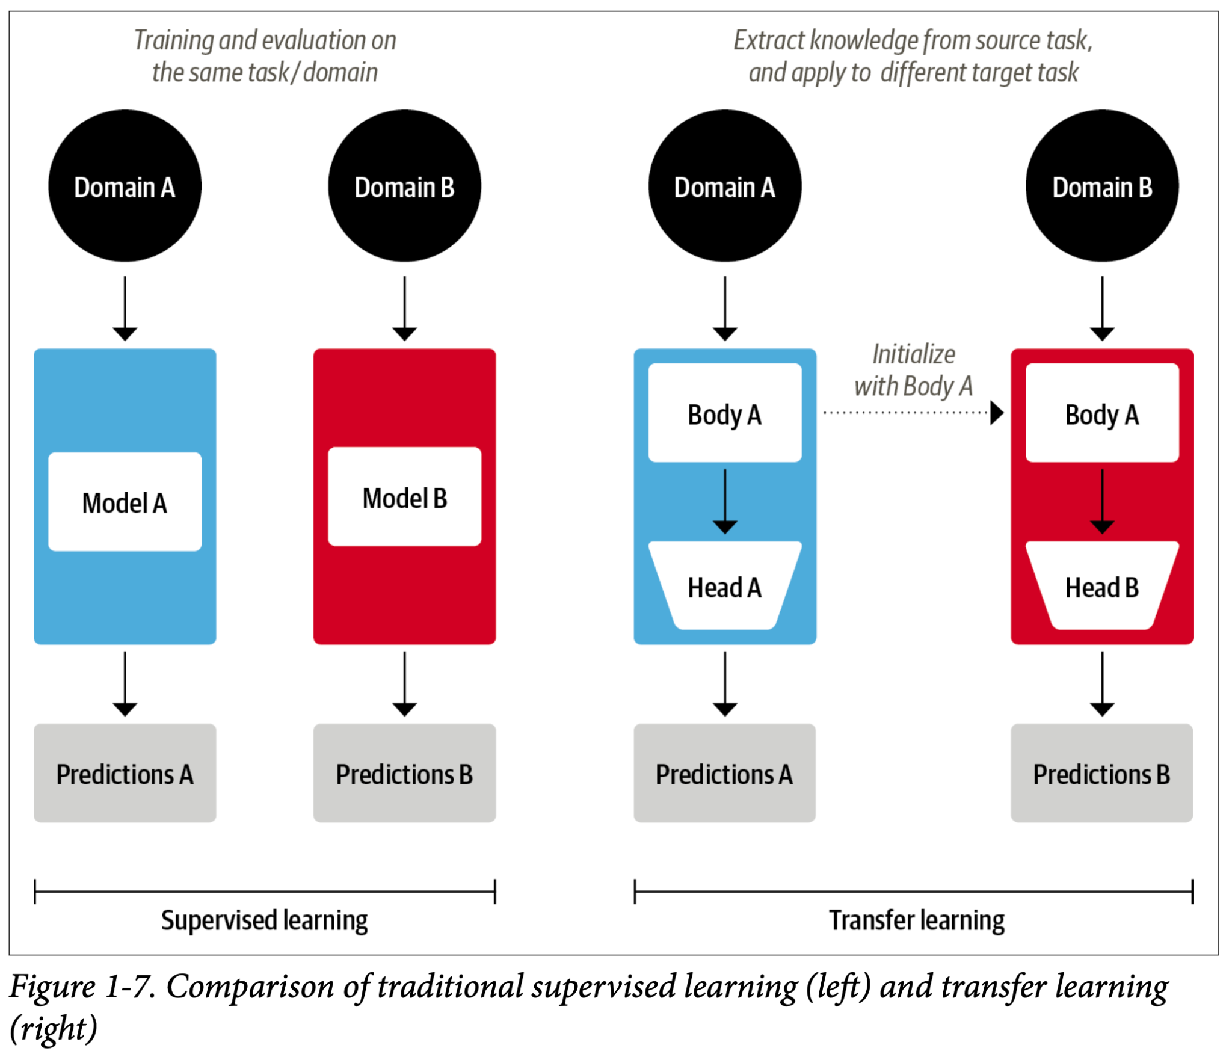

Slide 9
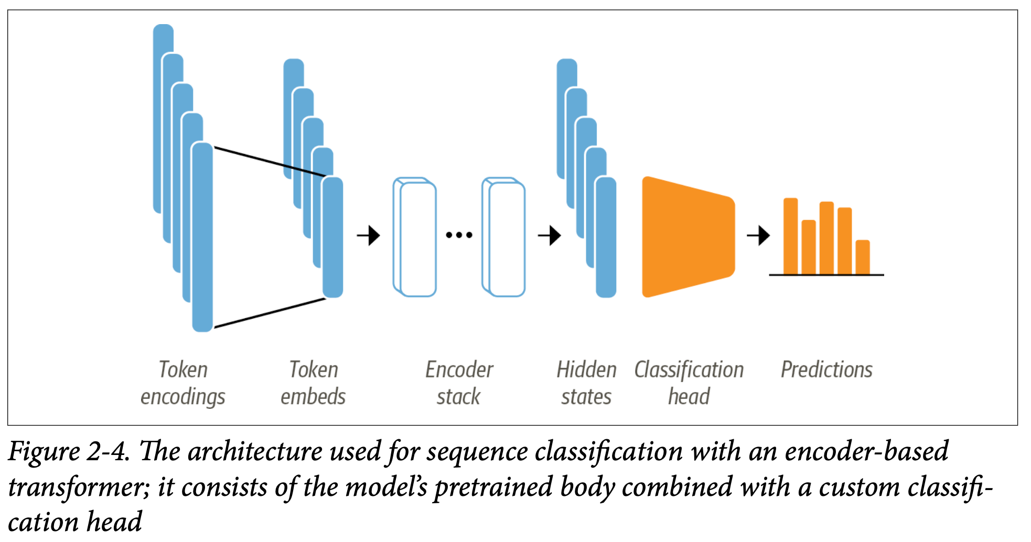

Slide 10
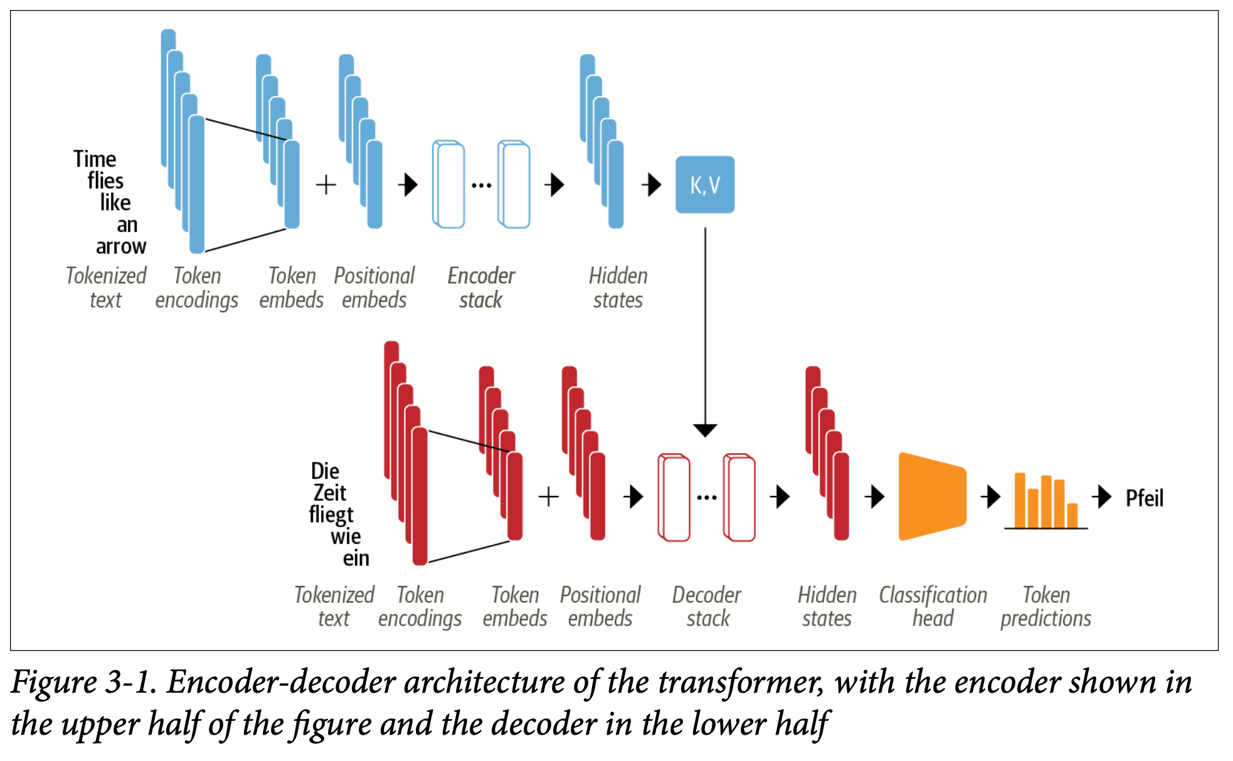

Slide 11
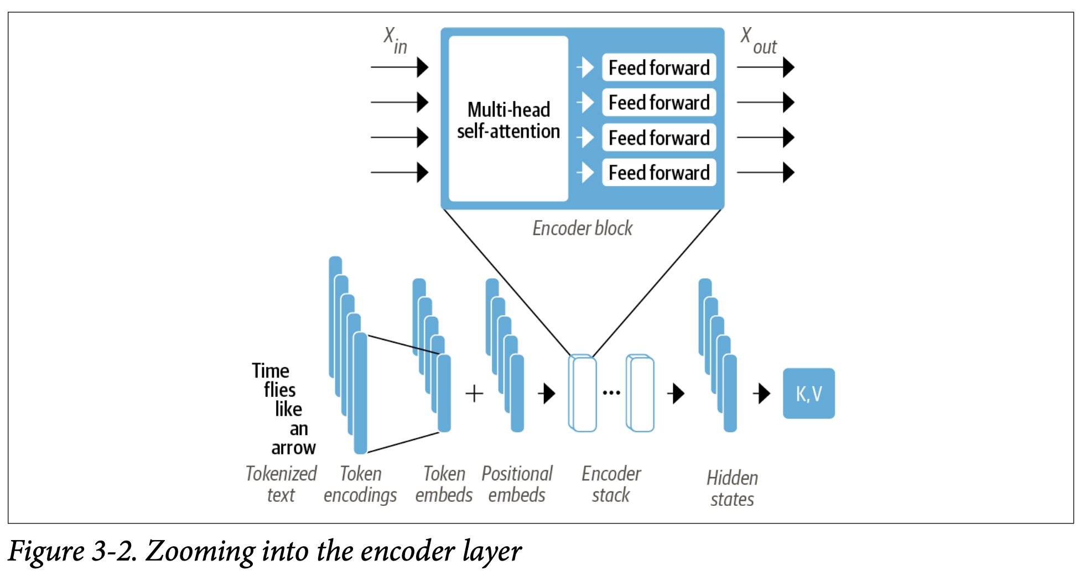

Slide 12
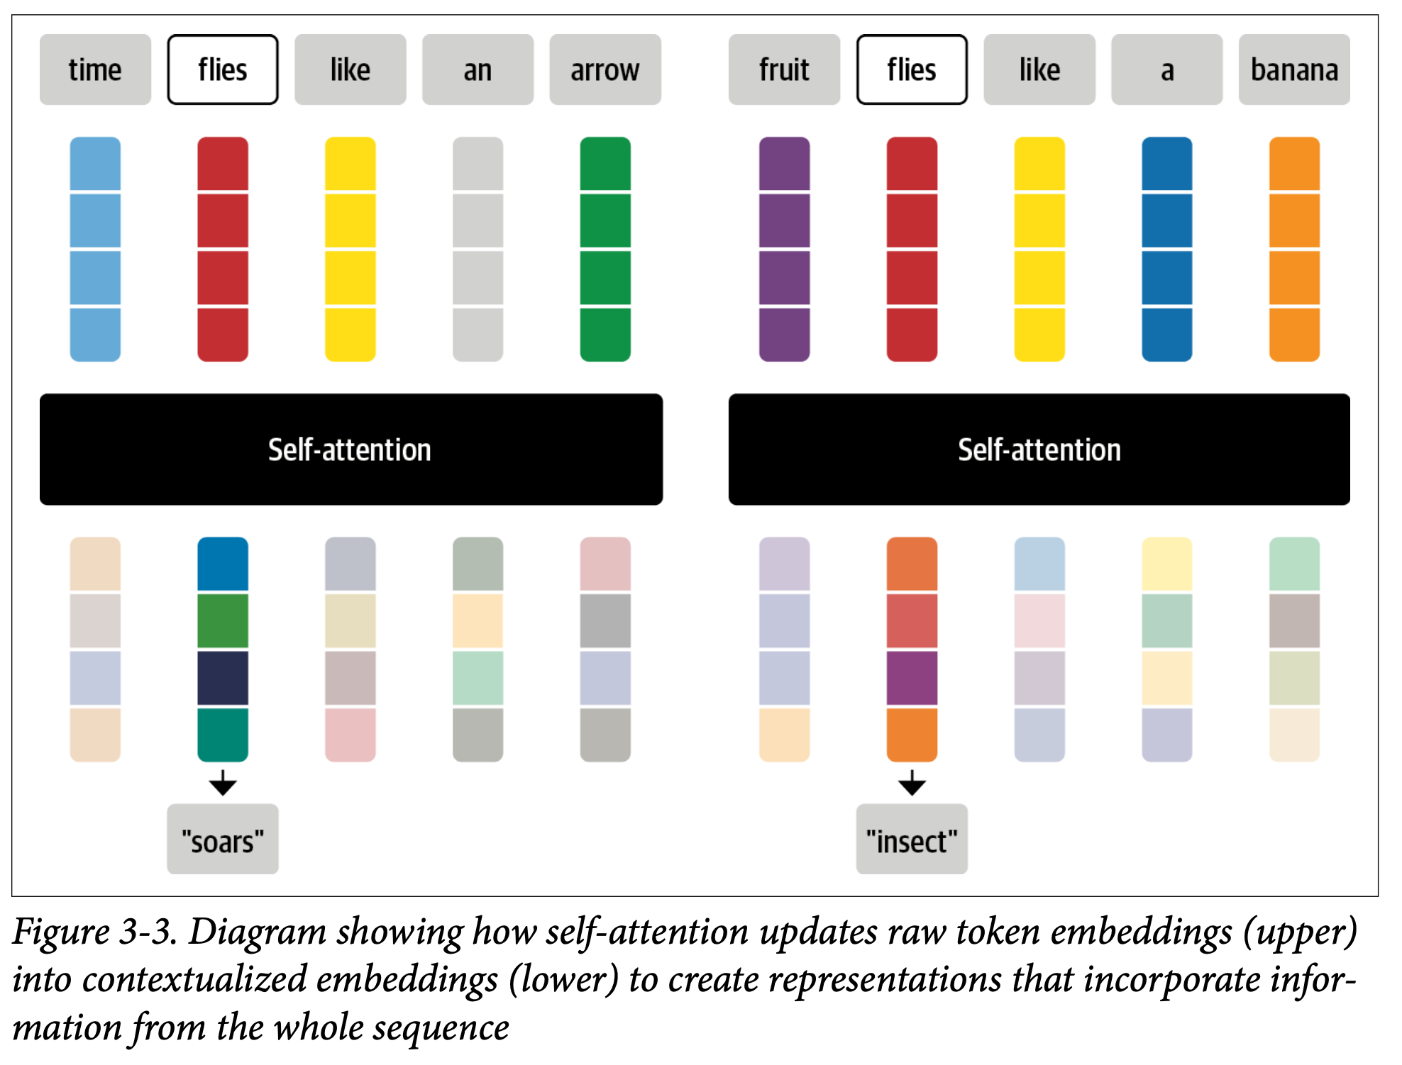

Slide 13


Slide 14
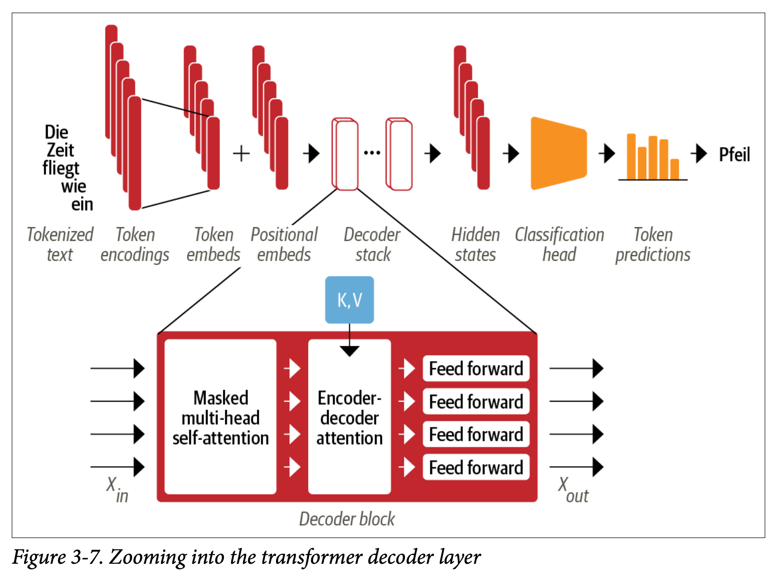

Slide 15
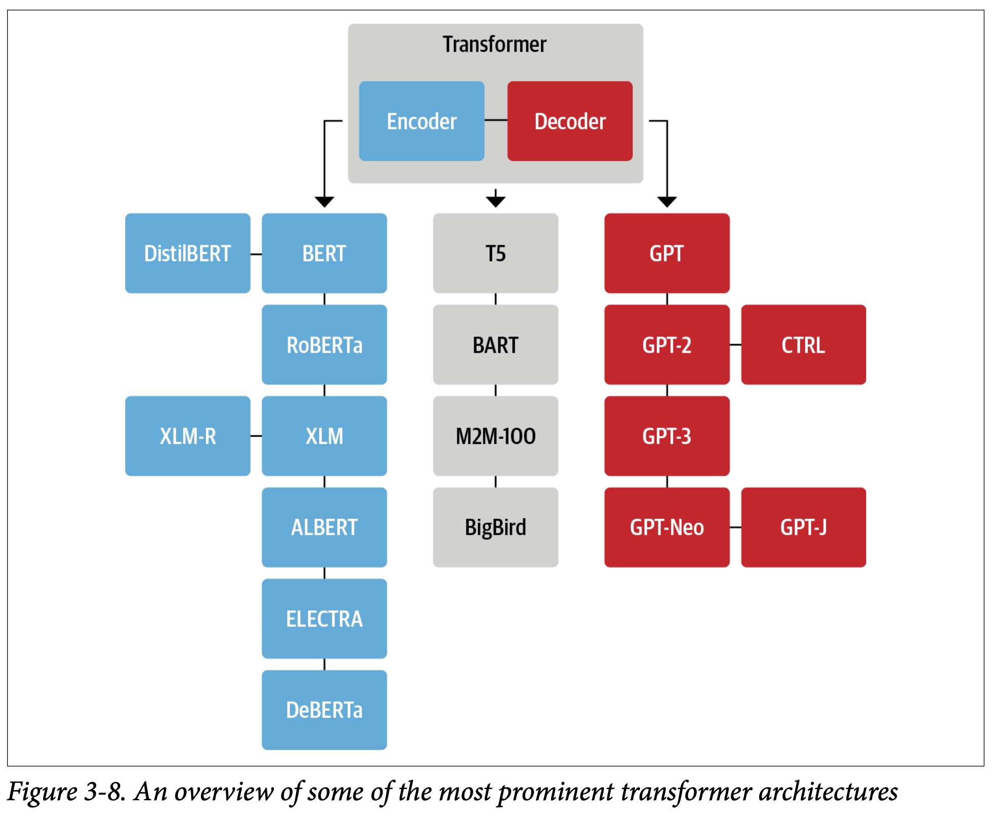

Slide 16
Questions?
Reference
Lewis Tunstall, Leandro von Werra, Thomas Wolf.
Natural Language Processing with Transformers: Building Language Applications with Hugging Face.
O'Reilly Media, 2022.

